Slide 1
Python communicating with USB devices.
Part 1...
Detecting Insertion and Removal of a USB device using pyudev
Hamilton Python User Group
https://github.com/HamPUG/
9 November 2015
Ian Stewart

Slide 2
Review of /sys/... and /dev/... directories
Using Files, File Manager, on Ubuntu Unity system to examine a Ubuntu 15.04 Mate partition...
Properties of /sys/...
Contents: nothing
Properties of /dev/...
Contents: 91 items, totalling 12.3 kB
.

Slide 3
Review of /sys/... and /dev/... directories
Having booted Ubuntu 15.04 Mate partition, examine...
Properties of /sys/...
21,926 items, totalling 612.8 MB
Properties of /dev/...
Contents: 533 items totalling 10.2kB

Slide 4
Review of /sys/... and /dev/... directories
Insert USB Gamepad...
Properties of /sys/…
Contents: 22,147 items, totalling 613.6 MB
Properties of /dev/...
Contents: 545 items totalling 10.6kB

Slide 5
Review of /sys/... and /dev/... directories
Remove USB Gamepad...
Properties of /sys
21,926 items, totalling 612.8 MB
Properties of /dev
Contents: 533 items totalling 10.2kB
.

Slide 6
Review of /sys/... and /dev/... directories
Insert USB Flash Drive...
Properties of /sys
Contents: 22,365 items, totalling 614.3 MB
Properties of /dev
Contents: 549 items totalling 10.6kB
.

Slide 7
Review of /sys/... and /dev/... directories
Summary...
System status | /sys/ items | Increase/Decrease | Size | Increase/Decrease
Powered off partition | 0 | -21,929 | 0 | -612.8MB
Powered on partition | 21,926 | 0 ←Reference | 612.8MB | 0 ←Reference
Add USB Gamepad | 22,147 | 221 | 613.6 MB | 0.8KB
Add USB Drive | 22,365 | 439 | 614.3 MB | 1.5MB
System status | /dev/ items | Increase/Decrease | Size | Increase/Decrease
Powered off partition | 91 | -442 | 0 | -12.3KB
Powered on partition | 533 | 0 ←Reference | 10.3 KB | 0 ←Reference
Add USB Gamepad | 545 | 12 | 10.6 KB | 0.3 KB
Add USB Drive | 549 | 16 | 10.6 KB | 0.3 KB

Slide 8
Review of /sys/... and /dev/... directories
Simplified Summary...
/sys/... initially zero items. Creating 21,929 items during booting would be a bit slow to do on disk, so it suggests a memory based file system structure.
Adding a USB device adds more items.
A simple USB device (Gamepad) does not add as many items as a more complex USB device (USB disk drive).

Slide 9
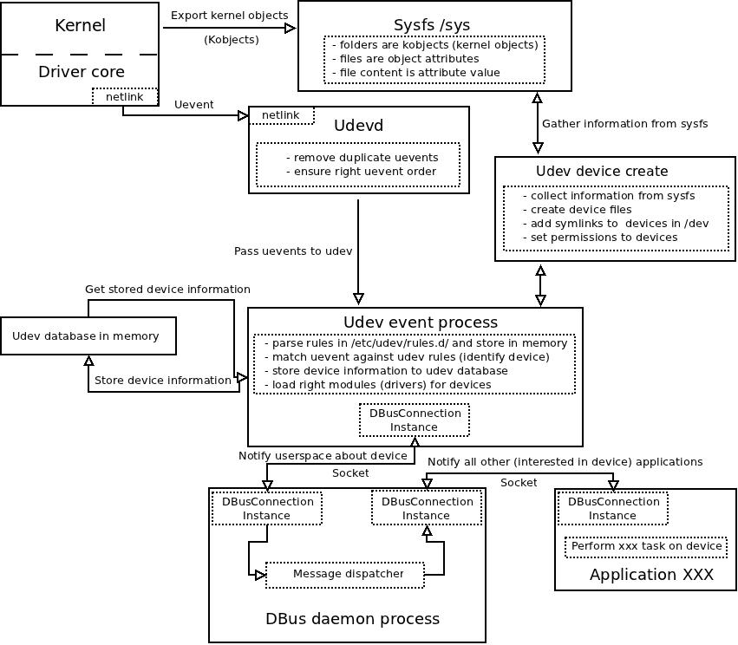
Overview diagram

Slide 10
lsusb Gamepad
lsusb
$ lsusb
Bus 002 Device 001: ID 1d6b:0002 Linux Foundation 2.0 root hub
Bus 006 Device 001: ID 1d6b:0001 Linux Foundation 1.1 root hub
Bus 005 Device 008: ID 0e8f:1005 GreenAsia Inc.
Bus 005 Device 001: ID 1d6b:0001 Linux Foundation 1.1 root hub
Bus 001 Device 001: ID 1d6b:0002 Linux Foundation 2.0 root hub
Bus 004 Device 002: ID 09da:0006 A4 Tech Co., Ltd Optical Mouse WOP-35 / Trust 450L Optical Mouse
Bus 004 Device 001: ID 1d6b:0001 Linux Foundation 1.1 root hub
Bus 003 Device 003: ID 0a5c:2110 Broadcom Corp. BCM2045B (BDC-2) [Bluetooth Controller]
Bus 003 Device 002: ID 0483:2016 STMicroelectronics Fingerprint Reader
Bus 003 Device 001: ID 1d6b:0001 Linux Foundation 1.1 root hub
$ lsusb -d 0e8f:
Bus 005 Device 008: ID 0e8f:1005 GreenAsia Inc.
$ lsusb -d 0e8f:1005
Bus 005 Device 008: ID 0e8f:1005 GreenAsia Inc.
Vendor ID
Product ID
USB Gamepad
Controller

Slide 11
lsusb --verbose of Gamepad
$ lsusb -d 0e8f:1005 --verbose
Bus 005 Device 008: ID 0e8f:1005 GreenAsia Inc.
Couldn't open device, some information will be missing
Device Descriptor:
bLength 18
bDescriptorType 1
bcdUSB 1.00
bDeviceClass 0 (Defined at Interface level)
bDeviceSubClass 0
bDeviceProtocol 0
bMaxPacketSize0 8
idVendor 0x0e8f GreenAsia Inc.
idProduct 0x1005
bcdDevice 1.00
iManufacturer 1
iProduct 2
iSerial 0
bNumConfigurations 1

Slide 12
lsusb -- verbose (continued)...
Configuration Descriptor:
bLength 9
bDescriptorType 2
wTotalLength 34
bNumInterfaces 1
bConfigurationValue 1
iConfiguration 2
bmAttributes 0x80
(Bus Powered)
MaxPower 100mA
Interface Descriptor:
bLength 9
bDescriptorType 4
bInterfaceNumber 0
bAlternateSetting 0
bNumEndpoints 1
bInterfaceClass 3 Human Interface Device
bInterfaceSubClass 0 No Subclass
bInterfaceProtocol 0 None
iInterface 2

Slide 13
lsusb -- verbose (continued)...
HID Device Descriptor:
bLength 9
bDescriptorType 33
bcdHID 1.00
bCountryCode 33 US
bNumDescriptors 1
bDescriptorType 34 Report
wDescriptorLength 110
Report Descriptors:
** UNAVAILABLE **
Endpoint Descriptor:
bLength 7
bDescriptorType 5
bEndpointAddress 0x81 EP 1 IN
bmAttributes 3
Transfer Type Interrupt
Synch Type None
Usage Type Data
wMaxPacketSize 0x0005 1x 5 bytes
bInterval 20

Slide 14
udevadm monitoring – plug in gamepad
$ udevadm monitor
monitor will print the received events for:
UDEV - the event which udev sends out after rule processing
KERNEL - the kernel uevent

Slide 15
udevadm monitoring
KERNEL[3171.908486] add /devices/pci0000:00/0000:00:1d.0/usb5/5-1 (usb)
KERNEL[3171.933287] add /devices/pci0000:00/0000:00:1d.0/usb5/5-1/5-1:1.0 (usb)
KERNEL[3171.954891] add /devices/pci0000:00/0000:00:1d.0/usb5/5-1/5-1:1.0/0003:0E8F:1005.0009 (hid)
KERNEL[3171.963640] add /devices/pci0000:00/0000:00:1d.0/usb5/5-1/5-1:1.0/0003:0E8F:1005.0009/input/input19 (input)
KERNEL[3171.963730] add /devices/pci0000:00/0000:00:1d.0/usb5/5-1/5-1:1.0/0003:0E8F:1005.0009/input/input19/event11 (input)
KERNEL[3172.016336] add /devices/pci0000:00/0000:00:1d.0/usb5/5-1/5-1:1.0/0003:0E8F:1005.0009/input/input19/js0 (input)
KERNEL[3172.016562] add /devices/pci0000:00/0000:00:1d.0/usb5/5-1/5-1:1.0/0003:0E8F:1005.0009/hidraw/hidraw1 (hidraw)

Slide 16
udevadm monitoring (continued...)
UDEV [3172.022176] add /devices/pci0000:00/0000:00:1d.0/usb5/5-1 (usb)
UDEV [3172.027258] add /devices/pci0000:00/0000:00:1d.0/usb5/5-1/5-1:1.0 (usb)
UDEV [3172.027295] add /devices/pci0000:00/0000:00:1d.0/usb5/5-1/5-1:1.0/0003:0E8F:1005.0009 (hid)
UDEV [3172.027357] add /devices/pci0000:00/0000:00:1d.0/usb5/5-1/5-1:1.0/0003:0E8F:1005.0009/input/input19 (input)
UDEV [3172.027384] add /devices/pci0000:00/0000:00:1d.0/usb5/5-1/5-1:1.0/0003:0E8F:1005.0009/hidraw/hidraw1 (hidraw)
UDEV [3172.029434] add /devices/pci0000:00/0000:00:1d.0/usb5/5-1/5-1:1.0/0003:0E8F:1005.0009/input/input19/js0 (input)
UDEV [3172.142497] add /devices/pci0000:00/0000:00:1d.0/usb5/5-1/5-1:1.0/0003:0E8F:1005.0009/input/input19/event11 (input)

Slide 17
/dev/ files created by plugging in Gamepad
$ ls -l /dev/hidraw1
crw------- 1 root root 248, 1 Nov 9 14:11 /dev/hidraw1
$ ls -l /dev/input/event11
crw-rw----+ 1 root input 13, 75 Nov 9 14:11 /dev/input/event11
$ ls -l /dev/input/by-id/
lrwxrwxrwx 1 root root 10 Nov 9 14:11 usb-GreenAsia_Electronics_Twin_USB_Digital_Gamepad-event-joystick -> ../event11
lrwxrwxrwx 1 root root 6 Nov 9 14:11 usb-GreenAsia_Electronics_Twin_USB_Digital_Gamepad-joystick -> ../js0

Slide 18
/dev/input/by-id/ Symbolic link
lrwxrwxrwx 1 root root 10 Nov 8 23:24 usb-GreenAsia_Electronics_Twin_USB_Digital_Gamepad-event-joystick -> ../event13
Path: /dev/input/by-id/usb-
Name: GreenAsia_Electronics_Twin_USB_Digital_Gamepad
Suffix: -event-joystick
Link: → ../event13
Symbolic link to: /dev/input/event13

Slide 19
pyudev
libudev...
Udev is a device manager for the Linux kernel
Initial release November 2003 – Linux 2.5.
Udev primarily manages device nodes in the /dev directory.
At the same time, udev also handles all user space events raised while hardware devices are added into the system or removed from it, including firmware loading as required by certain devices.
It's cumbersome and error-prone to walk the Sysfs tree from within an application's code. libudev is a convenient library to do this task.
Pyudev is the python bindings for libudev. Since 2010. Now at release 0.17.
$ sudo pip install pyudev

Slide 20
pyudev_demo_1.py
Python program to detect USB devices added and removed...
from pyudev import Context, Monitor
from pyudev.wx import MonitorObserver, EVT_DEVICE_EVENT
def device_event(event):
'''Callback for a change in a USB device.'''
print('Event Action: {0.device.action}'.format(event))
if __name__ == "__main__"
app = wx.App() # Use a GUI for a looping method.
# Establish the monitoring and callback to the function device_event()
context = Context()
#Create a monitor by connecting to the kernel daemon through netlink.
monitor = Monitor.from_netlink(context,source=u'udev')
monitor.filter_by(subsystem='input')
observer = MonitorObserver(monitor)
observer.Bind(EVT_DEVICE_EVENT, device_event)
monitor.start()
app.MainLoop()

Slide 21
Inserting / Removing the USB Gamepad,
$ python pyudev_demo_1.py
Event Action: add
Event Action: add
Event Action: add
Event Action: add
Event Action: add
Event Action: add
Event Action: add
Event Action: remove
Event Action: remove
Event Action: remove
Event Action: remove
Event Action: remove
Event Action: remove
Event Action: remove

Slide 22
pyudev_demo_2.py
Obtain the Action and the Device Path...
def device_event(event):
'''Callback for a change in a USB device.'''
print('Event Action: {0.device.action}\n'
'Device Path: {0.device.device_path}'
.format(event))

Slide 23
Inserting the Gampad ~ pyudev_demo_2.py
$ python pyudev_demo_2.py
Event Action: add
Device Path: /devices/pci0000:00/0000:00:1d.0/usb5/5-1
Event Action: add
Device Path: /devices/pci0000:00/0000:00:1d.0/usb5/5-1/5-1:1.0
Event Action: add
Device Path: /devices/pci0000:00/0000:00:1d.0/usb5/5-1/5-1:1.0/0003:0E8F:1005.0008
Event Action: add
Device Path: /devices/pci0000:00/0000:00:1d.0/usb5/5-1/5-1:1.0/0003:0E8F:1005.0008/input/input18
Event Action: add
Device Path: /devices/pci0000:00/0000:00:1d.0/usb5/5-1/5-1:1.0/0003:0E8F:1005.0008/hidraw/hidraw1
Event Action: add
Device Path: /devices/pci0000:00/0000:00:1d.0/usb5/5-1/5-1:1.0/0003:0E8F:1005.0008/input/input18/js0
Event Action: add
Device Path: /devices/pci0000:00/0000:00:1d.0/usb5/5-1/5-1:1.0/0003:0E8F:1005.0008/input/input18/event11

Slide 24
Filtering ~ pyudev_demo_3.py
context = Context()
monitor = Monitor.from_netlink(context, source=u'udev')
# Filtering
monitor.filter_by(subsystem='input')
observer = MonitorObserver(monitor)
observer.Bind(EVT_DEVICE_EVENT, device_event)
monitor.start()
============================================================
$ python pyudev_demo_3.py
Event Action: add
Device Path: /devices/pci0000:00/0000:00:1d.0/usb5/5-1/5-1:1.0/0003:0E8F:1005.000B/input/input21
Event Action: add
Device Path: /devices/pci0000:00/0000:00:1d.0/usb5/5-1/5-1:1.0/0003:0E8F:1005.000B/input/input21/js0
Event Action: add
Device Path: /devices/pci0000:00/0000:00:1d.0/usb5/5-1/5-1:1.0/0003:0E8F:1005.000B/input/input21/event11

Slide 25
Keys ~ pyudev_demo_4.py
print(event.device.keys())
[u'ACTION', u'DEVLINKS', u'DEVNAME', u'DEVPATH', u'ID_BUS', u'ID_FOR_SEAT', u'ID_INPUT', u'ID_INPUT_JOYSTICK', u'ID_MODEL', u'ID_MODEL_ENC', u'ID_MODEL_ID', u'ID_PATH', u'ID_PATH_TAG', u'ID_REVISION', u'ID_SERIAL', u'ID_TYPE', u'ID_USB_DRIVER', u'ID_USB_INTERFACES', u'ID_USB_INTERFACE_NUM', u'ID_VENDOR', u'ID_VENDOR_ENC', u'ID_VENDOR_ID', u'MAJOR', u'MINOR', u'SEQNUM', u'SUBSYSTEM', u'TAGS', u'USEC_INITIALIZED']

Slide 26
Get more items ~ pyudev_demo_4.py
print('Event Action: {0.device.action}\n'
'Device Path: {0.device.device_path}'.format(event))
# Two way to get the same thing?
print('Device DevName: {}'.format(event.device.get('DEVNAME')))
print('Device Node: {}'.format(event.device.device_node))
# Other info using get.(key)...
print('Device Vendor: {}'.format(event.device.get('ID_VENDOR')))
print('Device Model: {}'.format(event.device.get('ID_MODEL')))
print('Device Serial: {}'.format(event.device.get('ID_SERIAL')))
print('Vendor:Model {}:{}'.format(event.device.get('ID_VENDOR_ID'),
event.device.get('ID_MODEL_ID')))
====================================================================
Event Action: add
Device Path: /devices/pci0000:00/0000:00:1d.0/usb5/5-1/5-1:1.0/0003:0E8F:1005.000C/input/input22/event11
Device DevName: /dev/input/event11
Device Node: /dev/input/event11
Device Vendor: GreenAsia_Electronics
Device Model: Twin_USB_Digital_Gamepad
Device Serial: GreenAsia_Electronics_Twin_USB_Digital_Gamepad
Vendor:Model 0e8f:1005

Slide 27
Pyudev GUI support
Pyudev supports various GUI toolkits.
from pyudev.pyqt4 import MonitorObserver, EVT_DEVICE_EVENT
from pyudev.pyside import MonitorObserver, EVT_DEVICE_EVENT
from pyudev.glib import MonitorObserver, EVT_DEVICE_EVENT
from pyudev.wx import MonitorObserver, EVT_DEVICE_EVENT

Slide 28
pyudev
__end_of_part_1__
References:
https://www.kernel.org/doc/Documentation/filesystems/sysfs.txt
https://www.kernel.org/pub/linux/kernel/people/mochel/doc/papers/ols-2005/mochel.pdf
https://wiki.debian.org/DeviceManagement
https://wiki.debian.org/udev
http://www.signal11.us/oss/udev/
http://timocharis.com/help/udev.html
https://bobcares.com/blog/udev-introduction-to-device-management-in-modern-linux-system/
http://superuser.com/questions/839667/how-is-by-id-created-on-linux
https://pypi.python.org/pypi/pyudev
https://pypi.python.org/pypi/pyudev/0.17
https://pyudev.readthedocs.org/en/latest/
Overview Diagram (slide 9) from:
http://www.a-ticle.com/operating-systems/how-does-linux-kernel-detect-and-plug-in-your-hardware-kernel-sysfs-udev-and-dbus-collaboration/54/

